Slide 1

Project Presentation
Software Development Lab I
Course Code : CSE2142

Slide 2

Dept. of Computer Science
& Engineering
“Historical Place in BD”
Presented By:
Md. Asaduzzaman
Roll: 1737820123
2nd year, 1st semester.
Session: 2016-2017
Dept. of CSE
TMSS Engineering College
Project Supervisor
Subrata Kumar Paul
Lecturer
Dept. of CSE
TMSS Engineering College

Slide 3
Contents
Introduction
What is the project? Why need it?
Difference between Existing system (Pictures)
Language and tools
Requirement analysis
System design
Result/outcome/System input and Display output (Pictures)
Screenshot of Project
Applications/Impact on the society
Major References
Thanks! Any Question?

Slide 4
1. Introduction
Hello everyone welcome to my first project presentation, today I will want to show that the Historical Place in BD Project .In this project, I will represented 10 historical places in BD. This project will help Bangladeshi people to easily find the historical place, goes to this place safely within a short time.

Slide 5
2. What is the project? Why need it?
<>Historical Place in BD
<>To Know The Historical Places

Slide 6
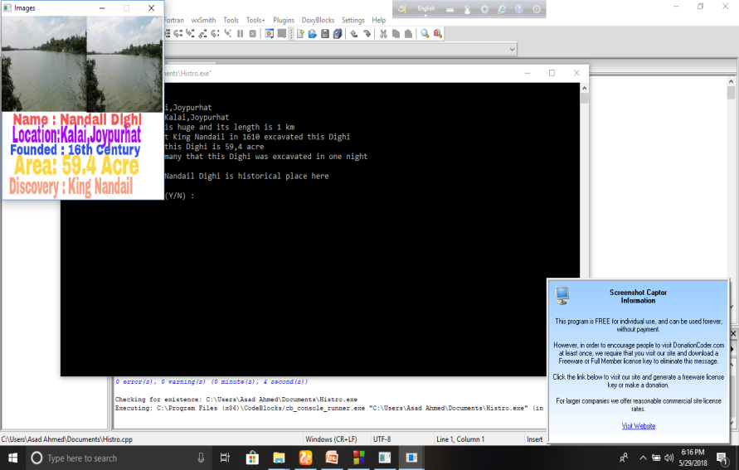
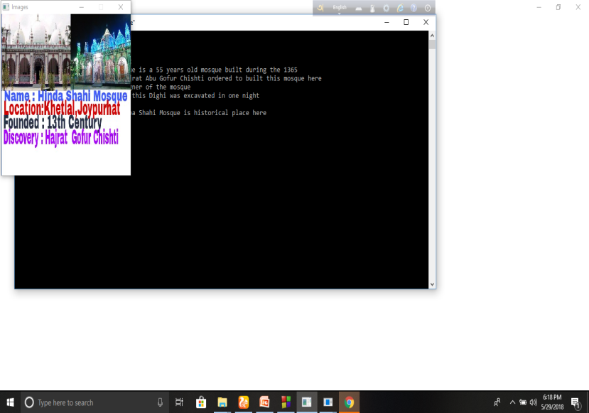
3. Difference between Existing system (Pictures)
Some Unknown Hisorical Places are add in this project,they are not used in previous system

Slide 7
4. Language and tools
<>Language: C++ Language
<> Tools: Windows 7,Windows 8,Windows 10

Slide 8
5. Requirement analysis
Requirement For Development
Area Of Project : Windows

Slide 9
6. System design
PLACE
DISTANCE
TIME
REASON

Slide 10
7. Result/outcome/System input and Display output
People Can Find the 10 Historical Places which is given in this project
People Can Easily Visited the historical Places
People Can Save their time by using this project

Slide 11
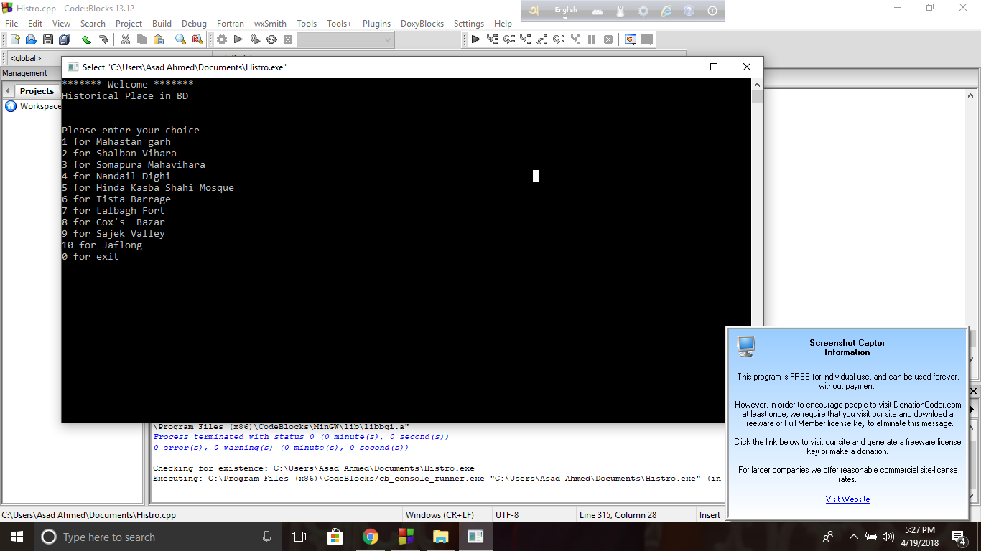
8.1 Screenshot of Project
Select Place

Slide 12
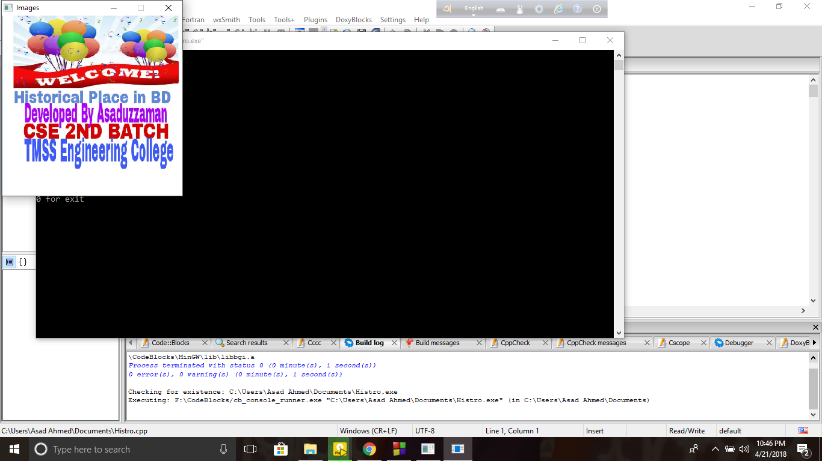
8.2 Screenshot of Project
Home Page

Slide 13
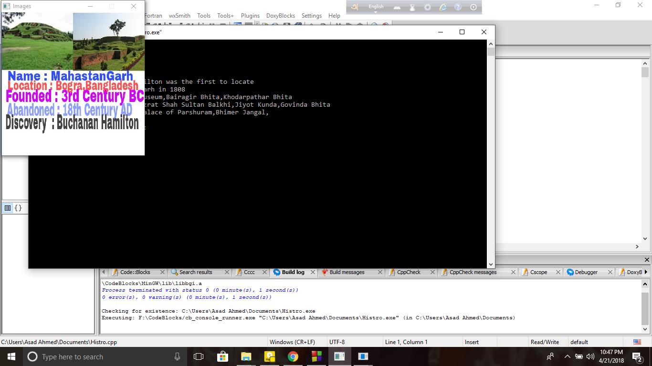
8. 3 Screenshot of Project
Choosen Place Info

Slide 14
9. Applications/Impact on the society
People can easily travel BD Historical Places
People can save their time
It is necessary for know the historical places in BD

Slide 15
10. Major References
Reference : Link 1, Link 2
Link 1:
http://www.cplusplus.com/forum/general/183524/
Link 2 :
https://github.com/AHfahim40/Historical-Place-in-BD-

Slide 16

11. Thanks! Any Question?
Thanks For Listening
Do You Have Any Question?

Slide 17
The END

